Slide 1
Harshad Mehta Scam

Slide 2
Table of content
Overview
Early life of Harshad
Market conditions
Scam
Whistleblower
Impact of the scam
Verdict

Slide 3
Overview
The “Securities Scam” refers to a diversion of funds to the tune of Rs. 3,500 crores from the banking system to various stockbrokers in a series of transactions (primarily in Government securities) during the period April 1991 to May 1992.

Slide 4
Early life of Harshad
Name: Harshad Shantilal Mehta
Born in: 29 July 1953, at Paneli Moti, Rajkot District
He earned degree in Bachelor of Commerce
Started his working life as an employee of the New India Assurance Company
Eventually, became a stock broker.

Slide 5
Market conditions
Banks – profits with the money they have
Government – regulate them (compulsory to invest in govt. securities) and wants to make some money.
Earlier, banks were required to show the balance sheet at the end of the day.
Hence, request relaxation in rule.

Slide 6
Market conditions
New rule – show balance sheet only Friday or once in fortnight.
This gave bank an opportunity to make money from govt. securities by lending them to other banks.
For such purpose brokers came in handy and Harshad was one such trusted broker.

Slide 7
Scam
By 1990 Harshad Mehta had risen to prominence in the stock market. He had been buying shares heavily. The shares which attracted his attention were:
- Associated Cement Co. (ACC),
- Apollo Tyres,
- Reliance,
- Tata Iron and Steel Co. ( TISCO ),
- BPL,
- Sterlite,
- Videocon.
He took the price of ACC from 200 to 9000.

Slide 8
The Instruments used in Scam
Ready Forward deal
Bank receipts
Notes:
Lets say that there are two banks A (short) and B (plus). Now what Harshad Mehta did was that he told the banker at A that he was dealing with many banks and hence did not know who would he deal in the end with. So he said that the bank should write the cheque in his name rather than the other bank (which was forbidden by law), so that he could make the payment to whichever bank was required. Since he was a trusted broker, the banks agreed. Then, going back to the example of bank A and B, he took the money from A and went to B and said that he would pay the money on the next day to B but he needed the bonds right now (for A). But he offered a 15 % return for bank B for the one day extension. Bank B readily agreed with this since it was getting such a nice return
Now since Harshad Mehta was dealing with many banks at the same time he could then keep some capital with him at all times. For eg. He takes money from A on Monday,
Now since Harshad Mehta was dealing with many banks at the same time he could then keep some capital with him at all times. For eg. He takes money from A on Monday,and tells B that he’ll pay on Tuesday, then he takes money from C on Tuesday and tells D that he’ll pay on Wednesday and the money he gets from C is paid to B and as a result he has some working capital with him at all times if this goes on with other banks throughout the week. The banks at that time were not allowed to invest in the equity markets. Harshad Mehta had very cleverly squeezed some capital out of the banking system. This capital he invested in the stock market and managed to stoke a massive boom.

Slide 9
Ready Forward Deal
A secured short-term (typically 15-day) loan from one bank to another
Bank lends against government securities
A broker usually brings together two banks for which he is paid a commission
The securities and payments were delivered through the broker in the settlement process
In such settlement the banks may not know with whom they are dealing
Borrower bank buys back their govt. securities at slightly higher rate.

Slide 10
The process of RF
Settlement Process
Payment of cheques
Dispensing of securities
Notes:
The Settlement Process:
The normal settlement process in government securities is that the transacting banks make payments and deliver the securities directly to each other.
During the scam, however, the banks or at least some banks adopted an alternative settlement process which was similar to the process used for settling transactions in the stock market.
In this settlement process, deliveries of securities and payments are made through the broker. That is, the seller hands over the securities to the broker who passes them on to the buyer, while the buyer gives the cheque to the broker who then makes the payment to the seller.
In this settlement process, the buyer and the seller may not even know whom they have traded with, both being known only to the broker.
There were two important reasons why the broker intermediated settlement began to be used in the government securities markets:
The brokers instead of merely bringing buyers and sellers together started taking positions in the market. In other words, they started trading on their own account, and in a sense became market makers in some securities thereby imparting greater liquidity to the markets.
When a bank wanted to conceal the fact that it was doing an RF deal, the broker came in handy. The broker provided contract notes for this purpose with fictitious counter parties, but arranged for the actual settlement to take place with the correct counter party.
Payment Cheques:
A broker intermediated settlement allowed the broker to lay his hands on the cheque as it went from one bank to another through him. The hurdle now was to find a way of crediting the cheque to his account though it was drawn in favor of a bank and was crossed account payee.
As it happens, it is purely a matter of banking custom that an account payee cheque is paid only to the payee mentioned on the cheque. In fact, exceptions were being made to this norm, well before the scam came to light.
Privileged (corporate) customers were routinely allowed to credit account payee cheques in favour of a bank into their own accounts to avoid clearing delays, thereby reducing the interest lost on the amount.
Normally, if a customer obtains a cheque in his own favour and deposits it into his own account, it may take a day or two for the cheque to be cleared and for the funds to become available to the customer. At 15% interest, the interest loss on a clearing delay of two days for a Rs. 100 crores cheque is about Rs. 8 lakhs.
On the other hand, when banks make payments to each other by writing cheques on their account with the RBI, these cheques are cleared on the same day.
The practice which thus emerged was that a customer would obtain a cheque drawn on the RBI favoring not himself but his bank. The bank would get the money and credit his account the same day.
This was the practice which the brokers in the money market exploited to their benefit.
Dispensing the Security:
The brokers thus found a way of getting hold of the cheques as they went from one bank to another and crediting the amounts to their accounts. This effectively transformed an RF into a loan to a broker rather than to a bank.
But this, by itself, would not have led to the scam because the RF after all is a secured loan, and a secured loan to a broker is still secured. What was necessary now was to find a way of eliminating the security itself!
There are three routes adopted for this purpose:
1. Some banks (or rather their officials) were persuaded to part with cheques without actually receiving securities in return. A simple explanation of this is that the officials concerned were bribed and/or negligent. A more intriguing possibility is that the banks' senior/top management were aware of this and turned a Nelson's eye to it to benefit from higher returns the brokers could offer by diverting the funds to the stock market. One must recognize that as long as the scam lasted, the banks benefited from such an arrangement. The management of banks might have been sorely tempted to adopt this route to higher profitability.
2. The second route was to replace the actual securities by a worthless piece of paper – a fake Bank Receipt (BR). This is discussed in greater detail in the next section.
3. The third method was simply to forge the securities themselves. In many cases, PSU bonds were represented only by allotment letters rather than certificates on security paper. And it is easier to forge an allotment letter for Rs. 100 crores worth of securities than it is to forge a 100 rupee note! Outright forgery of this kind however accounted for only a very small part of the total funds misappropriated
Bank Receipt:

Slide 11
Bank Receipts
In a RF deal securities were not moved back and forth in actuality
The borrower, i.e. the seller of securities, gave the buyer of the securities a Bank Receipt
Bank receipts serve three functions
1) Confirms the sale of securities.
2) States that the securities are held by the seller in trust for the
buyer.
3) Acts as a receipt for the received money by the selling bank.
In this scam Bank of Karad & Metropolitan Co-operative Bank had issued fake BR
Notes:
In an RF deal, as we have discussed it so far, the borrowing bank delivers the actual securities to the lender and takes them back on repayment of the loan. In practice, however, this is not usually done. Instead, the borrower gives a Bank Receipt (BR) which serves three functions:
The BR confirms the sale of securities.
It acts as a receipt for the money received by the selling bank. Hence the name – bank receipt.
It promises to deliver the securities to the buyer. It also states that in the meantime the seller holds the securities in trust for the buyer.
In short, a BR is something like an IOU (I owe you securities!), and the use of the BR de facto converts an RF deal into an unsecured loan. The lending bank no longer has the securities; it has only the borrower's assurance that the borrower has the securities which can/will be delivered if/when the need arises.
BRs Issued without Backing of Securities
As stated earlier, a BR is supposed to imply that the issuer actually has the securities and holds them in trust for the buyer. But in reality the issuer may not have the securities at all. There are two reasons why a bank may issue a BR, which is not backed by actual securities:
A bank may short sell securities, that is, it sells securities it does not have. This would be done if the bank thinks that the prices of these securities would decrease. Since this would be an outright sale (not an RF!), the bank issues a BR. When the securities do fall in value, the bank buys them at lower prices and discharges the BR by delivering the securities sold. Short selling in some form is an integral part of most bond markets in the world. It can be argued that some amount of shortselling subject to some degree of regulation is a desirable feature of a bond market. In our opinion, an outright sale using a BR, which is not backed by securities, is not harmful per se though it violates the RBI guidelines.
2. The second reason is that the bank may simply want an unsecured loan. It may then do an RF deal issuing a "fake" BR which is a BR without any securities to back them. The lending bank would be under a mistaken impression that it is making a secured loan when it is actually advancing an unsecured loan. Obviously, lenders should have taken measures to protect themselves from such a possibility (This aspect will be examined later when we discuss the banks' control system in general and counterparty limits in particular.)
During the scam, the brokers perfected the art of using fake BRs to obtain unsecured loans from the banking system. They persuaded some small and little known banks – the Bank of Karad (BOK) and the Metropolitan Cooperative Bank (MCB) - to issue BRs as and when required. These BRs could then be used to do RF deals with other banks. The cheques in favour of BOK were, of course, credited into the brokers' accounts. In effect, several large banks made huge unsecured loans to the BOK/MCB which in turn made the money available to the brokers.

Slide 12
Flow
Issue fake BR
Borrower bank
Broker
Harshad Mehta
Lender bank
Funds

Slide 13
Whistleblower
On April 23, 1992, journalist Sucheta Dalal exposed Mehta's scam
The first press report appeared indicating that there was a shortfall in the Government Securities held by the State Bank of India. In a little over a month, investigations revealed that this was just the tip of an iceberg which came to be called the securities scam, involving misappropriation of funds to the tune of over Rs. 3500 crores.

Slide 14
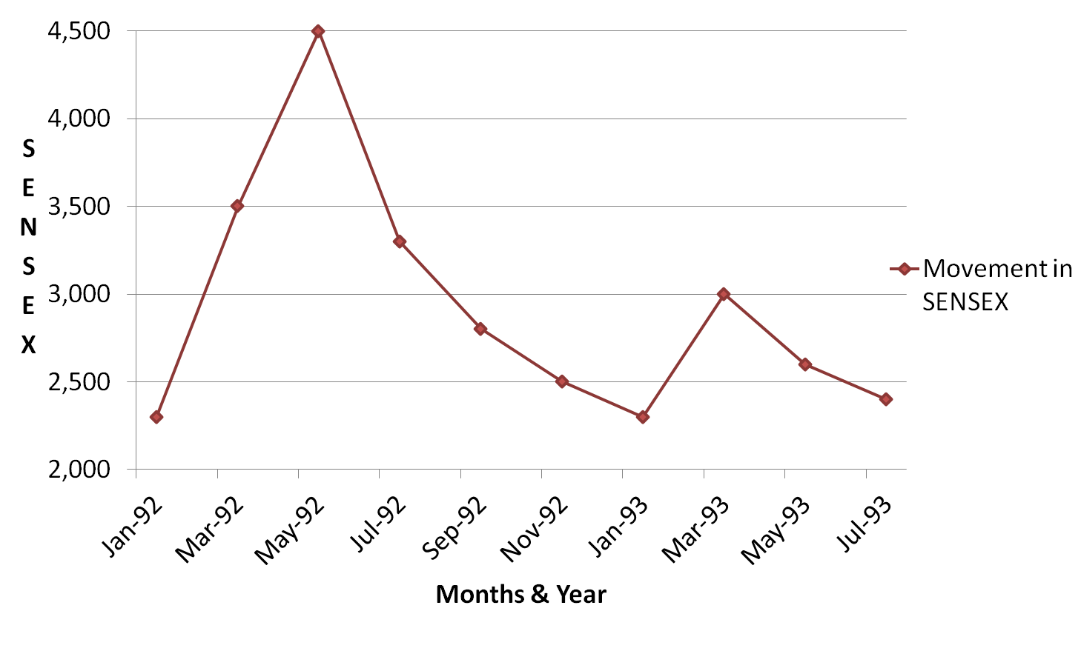
Impact Of Scam On Market
Notes:
He believed in bull market , which was very rare at that time. And believed in rising the price instead of decreasing it.
The index fell from 4500 to 2500 representing a loss of Rs. 100,000 crores in market capitalization.

Slide 15
Impact
Mehta had by then swindled the banks of a staggering Rs 3,500 crore
Government was heavily criticised for their Liberalisation policy.
Holding banks of fake BR had to face losses
BR was removed by RBI
SEBI postponed sanctioning of private sector mutual funds

Slide 16
Impact on others
M. J. Pherwani of UTI also died in the scandal due to heart attack
K. M. Margabandhu, then CMD of UCO Bank was arrested
V. Mahadevan, one of the M.D. of India’s largest Bank, the S.B.I., were removed from his office

Slide 17
Regulatory Actions Taken Against Mehta
He was later charged with 72 criminal offenses, and more than 600 civil action suits were filed against him
He was arrested and banished from the stock market
Mehta was arrested by the CBI on November 9, 1992 for allegedly misappropriating more than 27 lakh shares of about 90 companies

Slide 18
Its all about the money!
Where has all the money gone?
It is rumored that a part of the money was sent out of India through the Havala, converted into dollars/pounds, and brought back as India Development Bonds.
Notes:
People also say that this big scam cant be done by one person, so all the money was divided whos mane was never been disclosed

Slide 19
This game, too, did not last long.
He died in Thane Prison, Mumbai.
He complained of chest pain and was moved to a hospital, where he died, at the age of 47, 31st Dec. 2001
Died due to heart ailment.
Notes:
During his judicial custody, while he was in Thane Prison, Mumbai, he complained of chest pain and was moved to a hospital, where he died, at the age of 47, 31st Dec. 2001. Mehta’s death remains a mystery. Some believe that he was murdered ruthlessly by an underworld nexus.In this context, it might be noteworthy that a certain criminal allegedly connected with this nexus had inexplicably surrendered just days after Harshad Mehta was moved to Thane Jail and landed up in imprisonment in the same Jail, in the cell next to Harshad Mehta.

Slide 20
Harshad Mehta knew the loopholes in banking system as well as how to exploit those loopholes.
His whole intension to do this was to rise in SENSEX.

